Slide 1
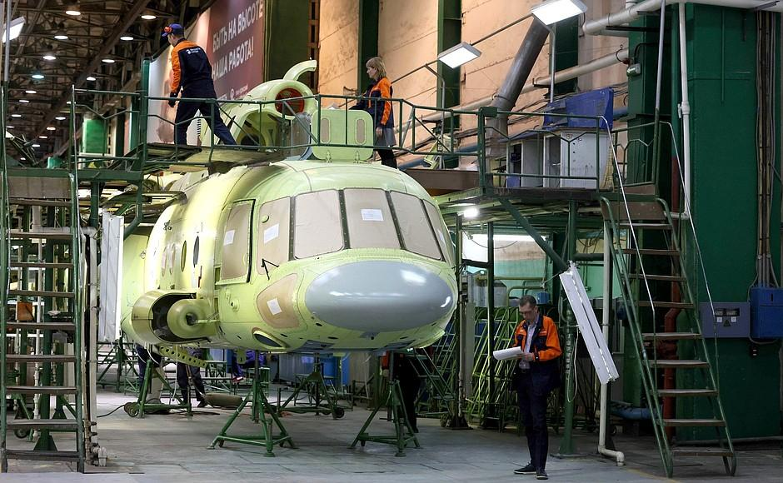
Machine Part or Batch Label Recognition with MNIST Handwritten Digit Recognition
Enhancing Inventory Tracking and Reducing Errors in Manufacturing
NAME: Harichandana.Nursing
DATE: 28/10/2024

Slide 2
Use Case: Manufacturing parts and batches are often labeled by hand, making traditional tracking methods prone to errors and delays.
Solution: A digit recognition model trained on MNIST can identify and convert these handwritten labels into digital data directly from photos or scans.
Benefits: This solution automates data entry, reduces errors, and speeds up inventory tracking, ultimately improving operational efficiency.

Slide 3
PROBLEM:
Title: Problem Statement: Handwritten Labels in Manufacturing
Content:
Parts or batches often have handwritten labels for identification.
Manually entering this information is time-consuming and prone to errors.
Need for automated recognition to improve efficiency and accuracy.

Slide 4
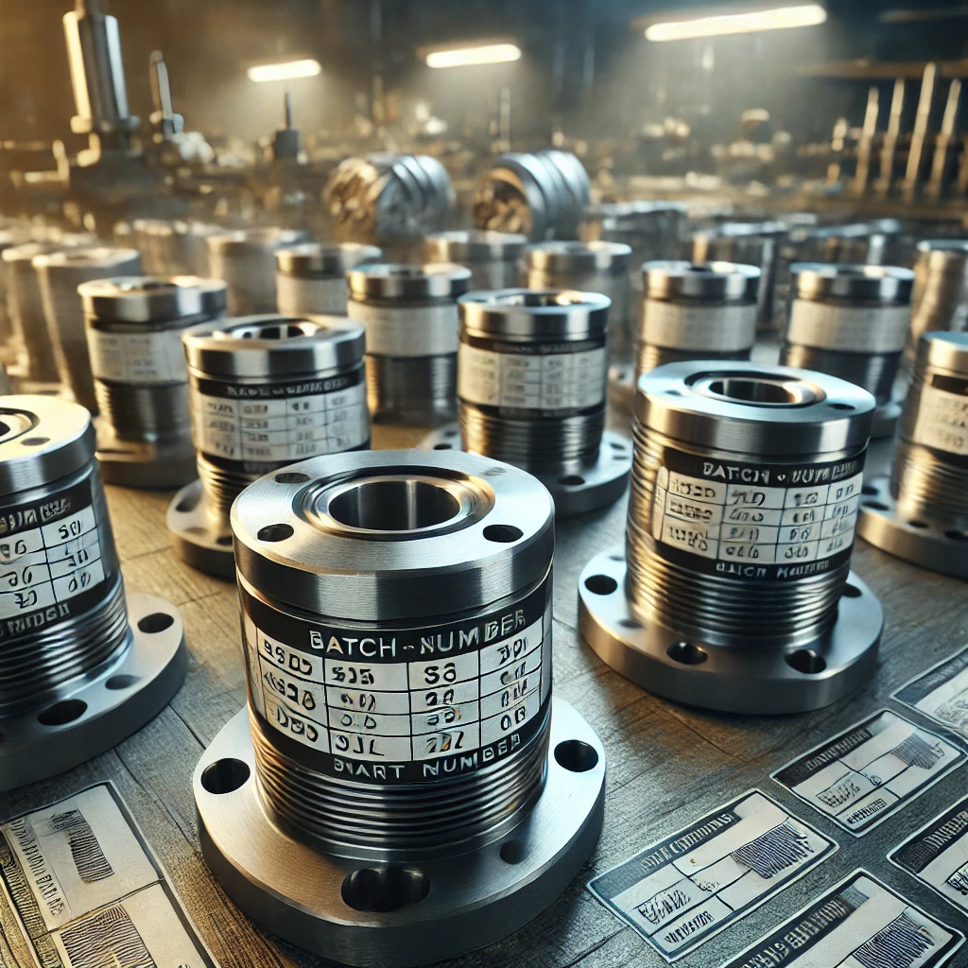
Parts with handwritten labels.

Slide 5
SOLUTION:
Title: Automated Recognition with MNIST
Content:
Train a model using MNIST data to recognize handwritten digits.
The model recognizes batch numbers or part IDs from photos or scans.
Simplifies data entry and enhances inventory tracking accuracy.

Slide 6
MNIST Data Set Introduction
TITLE: MNIST Dataset
Contains 70,000 images of handwritten digits (0-9).
Images are 28x28 grayscale pixels, ideal for training recognition models.
Commonly used for digit recognition tasks.

Slide 7
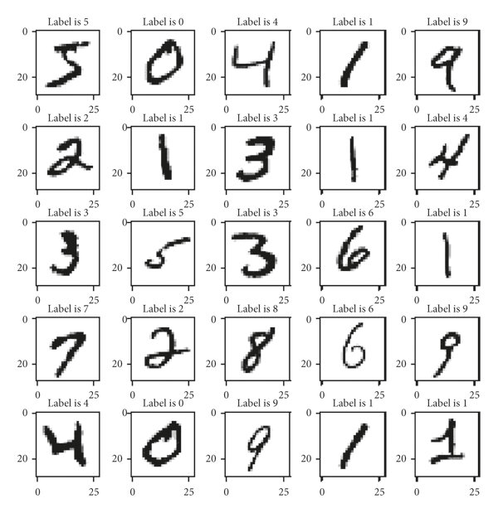
SAMPLE OF MNIST DATASET:

Slide 8
Technical Workflow:
Title: Technical Workflow for Label Recognition
Content:
Step 1: Capture photo of the part label.
Step 2: Preprocess the image (grayscale conversion, noise reduction).
Step 3: Run digit recognition model trained on MNIST.
Step 4: Output recognized label for inventory entry.

Slide 9
Model Training & Recognition Process:
Content:
MNIST model training process: image preprocessing,KNN,NAIVE-BAYES,NON-NAIVE BAYES models training and validation.
Recognition process: model outputs digits from image, post-processed to form batch/part ID.

Slide 10


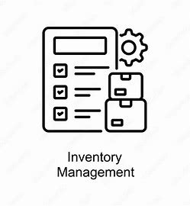
Benefits of MNIST-based Recognition:
Key Benefits of MNIST-based Recognition for Manufacturing
Content:
Automated, fast data entry.
High accuracy and reduced human error.
Real-time inventory updates.

Slide 11
RESULTS:
TITLE: Results and Potential Impact
Content:
Increased efficiency in data handling.
Reduction in inventory errors.
Scalable solution for other handwritten information in manufacturing.

Slide 12
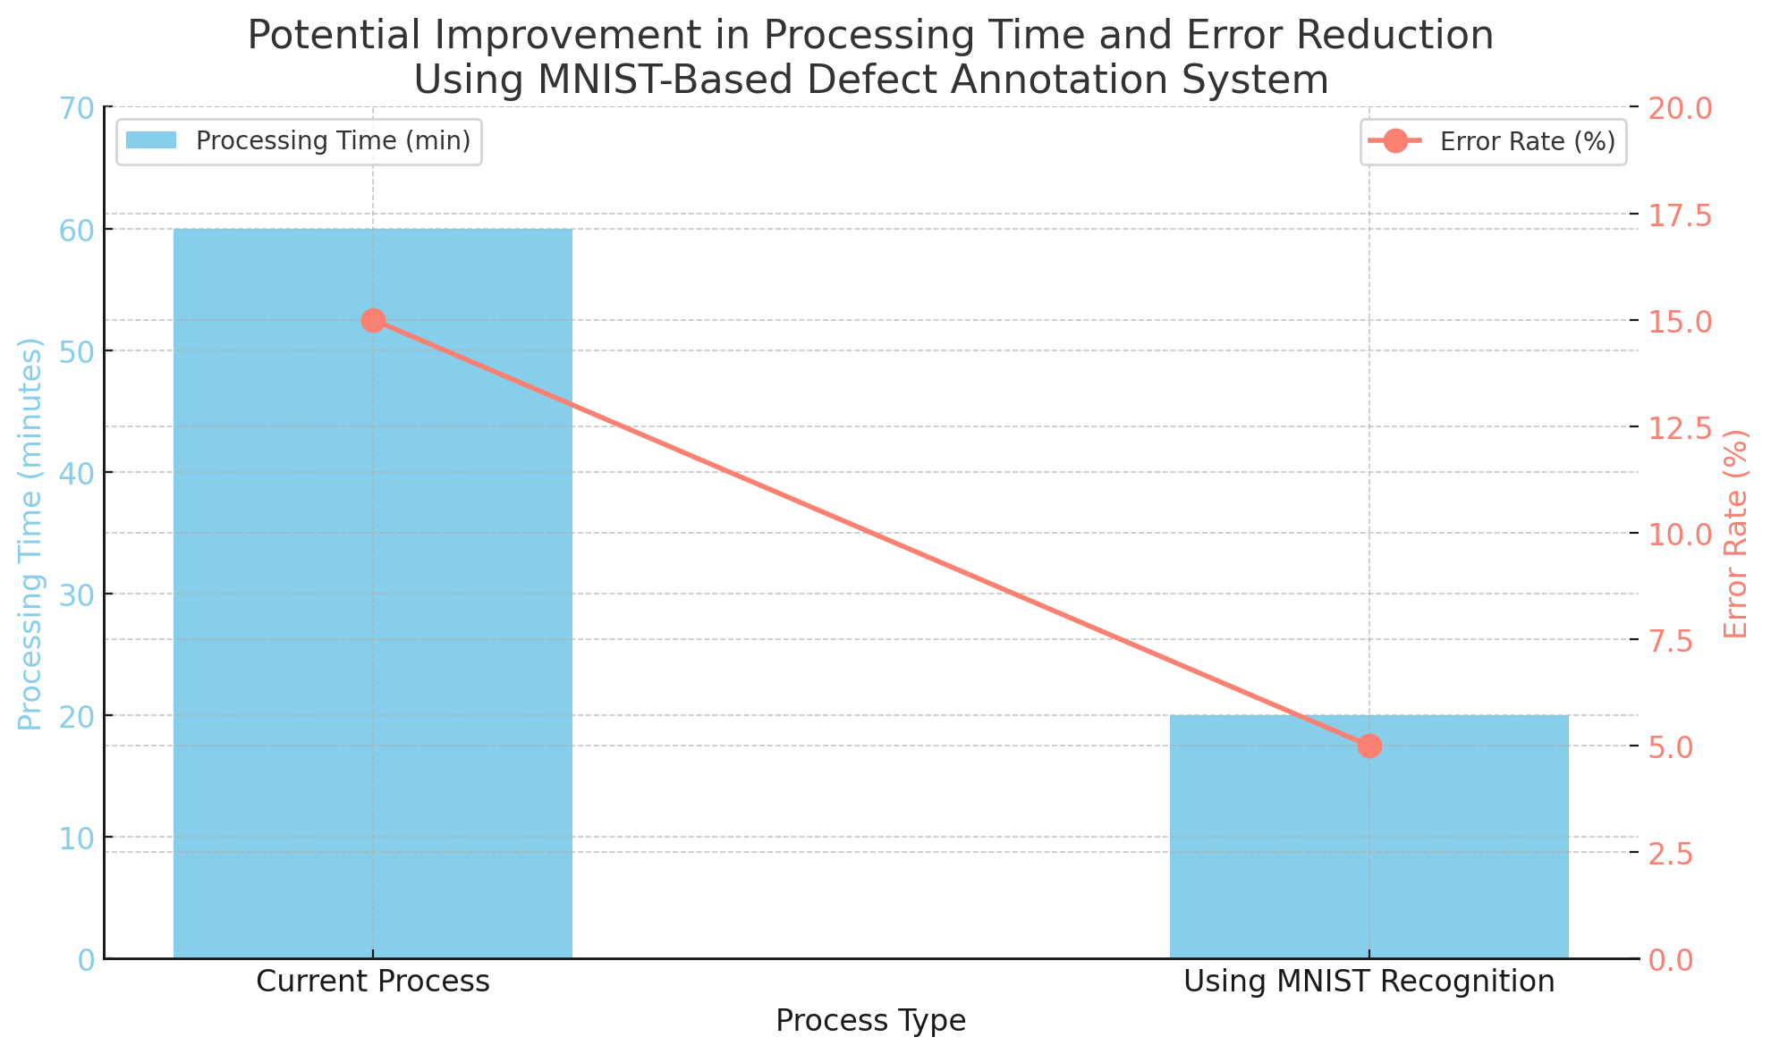
Graph showing potential improvement in processing time or reduction in errors.

Slide 13
MODEL COMPARISON:
KNN
Process: Flatten the images into a 784-dimensional vector, and calculate the Euclidean distance between vectors.
OUTPUT:Predict the digit by identifying the majority label among the KKK nearest neighbors .
Accuracy: 96.84%
Naive-Bayes
Assumption: Each pixel is treated as an independent feature.
Calculation: For each pixel intensity in a given class (like digit “3”), calculate its likelihood assuming Gaussian distribution.
Accuracy: - 62.64%
Non-Naive Bayes
Accuracy: 75.32%

Slide 14
SUMMARY:
Machine Part or Batch Label Recognition using MNIST Handwritten Digit Recognition is a system designed to automate the recognition and digitization of handwritten labels on parts or batches in manufacturing.
This process helps streamline inventory tracking and reduces human error by leveraging a machine learning model trained on the MNIST dataset, which consists of thousands of labeled images of handwritten digits.

Slide 15
THANKYOU

